Slide 1
How to use this template
Make a copy to your Google Drive
Read speaker’s notes — there’s some guidance there
Edit to your liking
Use in your presentation or print out
Remember to discard this first page
Any questions? Give Wojtek Kutyla a shout on Slack.

Slide 2
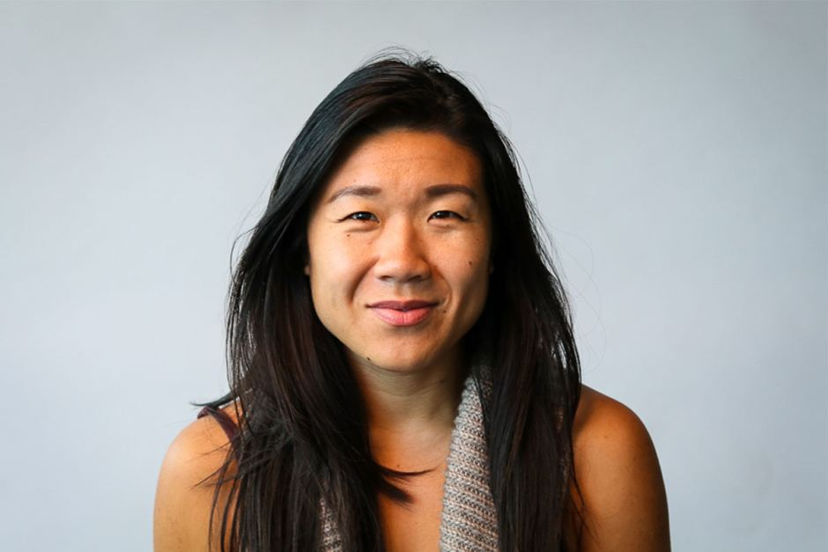
Your proto-persona’s name
Behaviours
Meg
Works long hours at the gym
Demographic information
Needs and goals
Self-employed PT
Works at Barbreck Studio
Needs to track who is attending her classes
Would like to be able to easily add classes as she is always attending new courses.
Notes:
When naming your proto-persona, keep it real. The goal is to empathise with them, and if their name is Bilbo Baggins it’s rather hard.
Remember to download only non-watermarked, free-to-use photographs. Use Creative Commons search in Google or Flickr to find such photos. Make these appear and feel 'real'.
When establishing basic characteristics, keep it short and simple. Who are they?
Demographic information should be relevant to the project. Think of all aspects that might affect how people interact with your product. Think of the following first:
Where do they work/what they do?
What’s their relationship status? Do they have children?
How much do they earn — and is this relevant?
What’s their level of familiarity with digital technologies?
Add your own.
Behaviours are simply things that they do. Keep it relevant to the project.
Needs and goals — this is what they want from the product and your organisation.

